Slide 1
Future of Dublin: How to make policy that works for all
Dr Arpita Chakraborty

Slide 2
Who am I?
Vice-Director, Institute for Research on Genders and Sexualities
More than a decade’s experience as a researcher on gender, caste and race
Worked with NGOs, governments, universities in more than 7 countries

Slide 3
Imagining the future Dublin
How does it look for you?

Slide 4
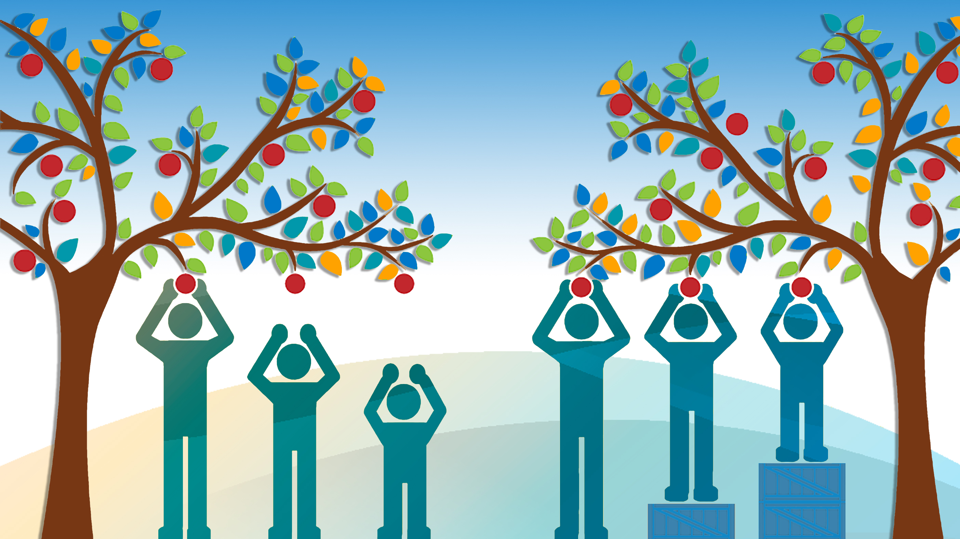
Equity

Slide 5
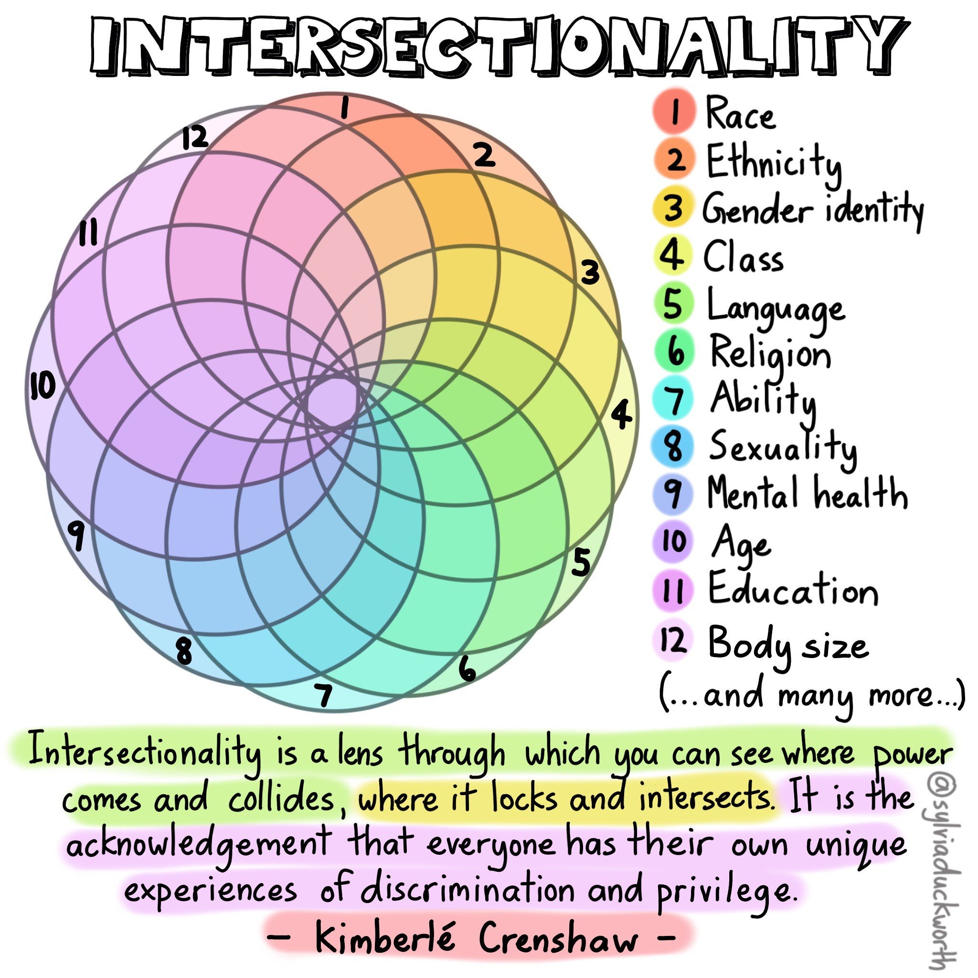

Slide 6
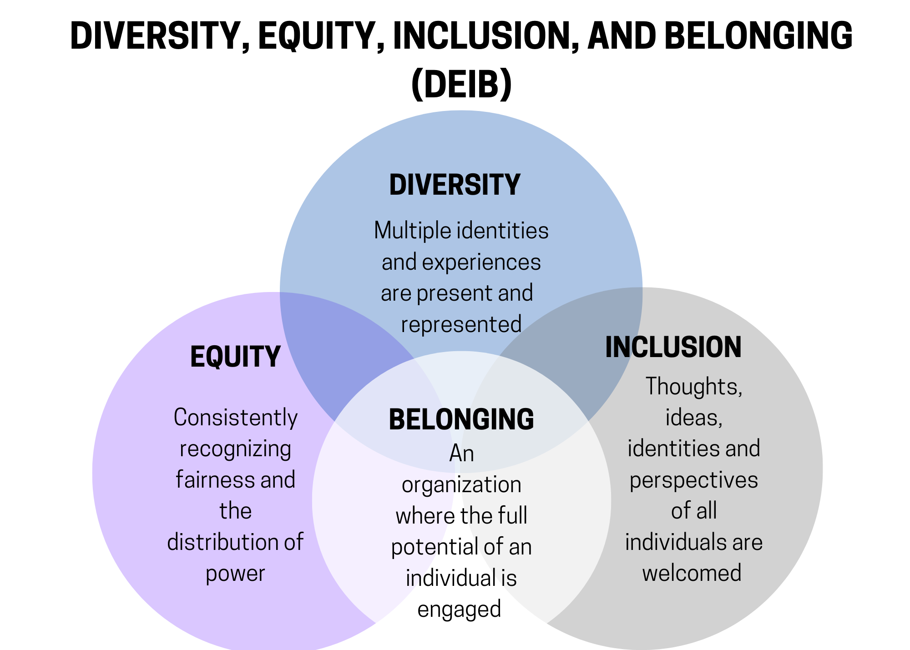
Our Dublin

Slide 7
Equality Laws
Nine protected grounds
Age
Civil Status
Disability
Family Status
Gender
Membership of the Traveller Community
Race
Religion
Sexual Orientation

Slide 8
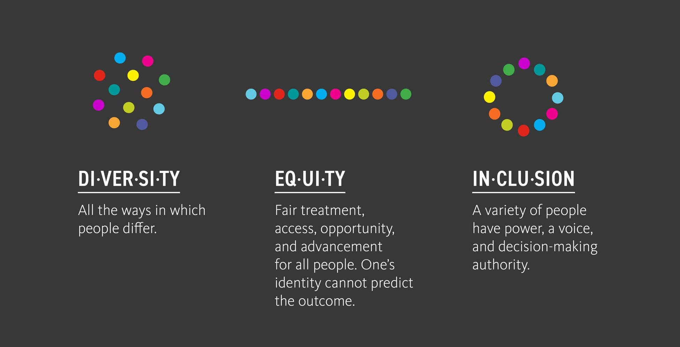
Think about…

Slide 9
What it means for policy makers
Thinking about how the policy will impact different groups
Listen and act with communities
Ensuring the voices from these groups are heard

Slide 10
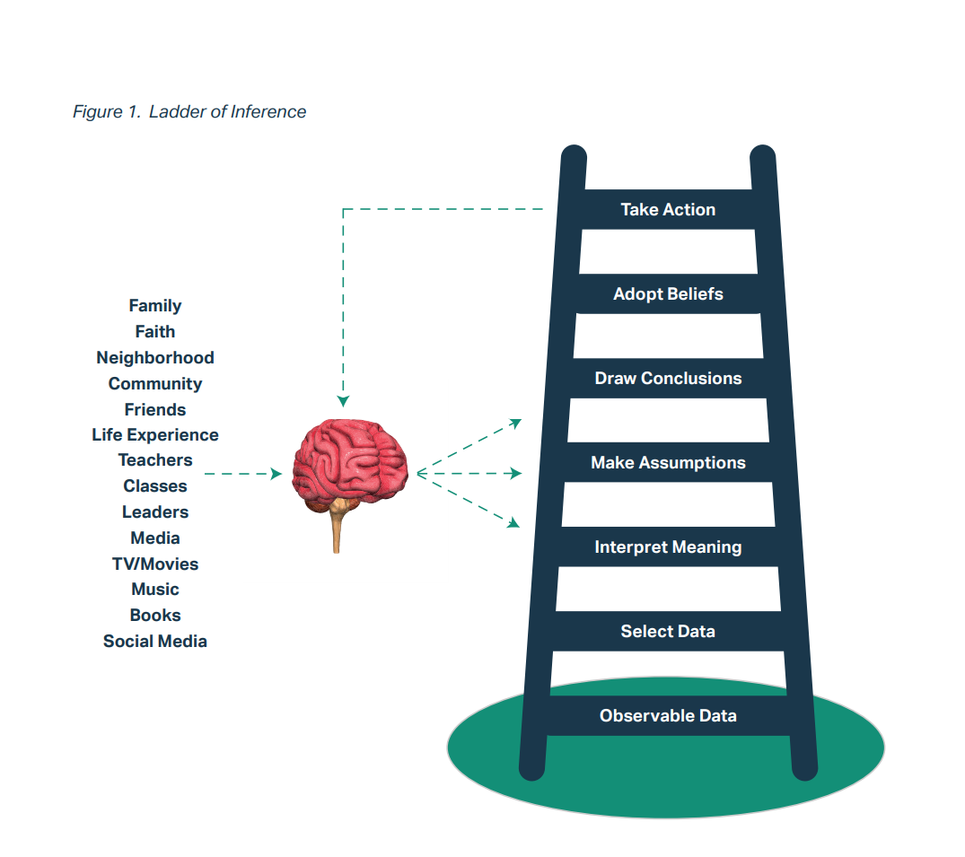
Notes:
Harvard Professor Chris Argyris’s Ladder of Inference is a model that describes how our brain translates the data we encounter into beliefs and actions we take. This process happens in a millisecond. In any situation, we experience a large pool of data (sensory stimulus, information). Our life experience shapes the categorization in our brain and our implicit biases, which inform which data we notice and pay attention to, how we interpret that data, the assumptions we make, and, ultimately, our beliefs, actions, and patterns.
The Ladder of Inference reminds us why it is so important to test our observations, interpretations, and assumptions. This is especially true if they are about people or communities that are not our own. We need to check in with people different from us before drawing conclusions. And we must be aware that we have implicit biases and patterns that shape our beliefs and actions.

Slide 11
Discrimination and Bias Patterns
Perceive self as free of biases and prejudices
Avoid conversations about difference
Feel shameful about having prejudices
Ignore or minimize differences (e.g., “We’re all the same” or “I’m colorblind”)
My intent matters most (“If I didn’t mean any harm, then my behaviour is okay regardless of its impact on someone else.”)
Homogenizing other communities (not acknowledging the diversity and complexity within groups)
Self-righteous about equity work and knowledge
Judge others who you do not perceive as committed to equity

Slide 12
Discrimination and Bias Patterns
Diffuse or reject responsibility for working on equity (“It is not my problem.”)
Believe our way of doing things is the right way and others’ approaches are less valid; they should adapt to our way
Not speaking up or intervening when witnessing discriminatory behaviours and practices, including microaggressions
Minimize others’ experience of prejudice or bias (“Are you sure that happened? They probably didn’t mean it.”)
Deferring to white people for advice, guidance, or expertise
Decide people’s interests or skill sets based on their group (assuming a minoritized volunteer will be more interested in community services than the business side of an organization)
Shame or negative view of one’s own race or ethnicity
Minimize or invalidate one’s own experiences of prejudice or bias (“It’s not that bad; others have it worse.”)

Slide 13
Discrimination and Bias Patterns
Blame oneself for being targeted by racism
Shame for looking different or desiring to fit in with status quo of dominant groups, culture
Feeling the need to always prove you belong (overcompensating by emphasizing credentials, not asking for assistance)
Comparing your underrepresented group against others; minimizing or competing with other underrepresented groups

Slide 14
For every pattern you identified
Please answer the following questions:
How does this pattern show up in my life? How does it show up in my equity work?
How does this pattern impede me? How does it impede my work with others?

Slide 15
Reflect as an ally
Consider your own background; how have these policies affected your and your family’s opportunities across generations?
How can you extend this benefit to others?

Slide 16
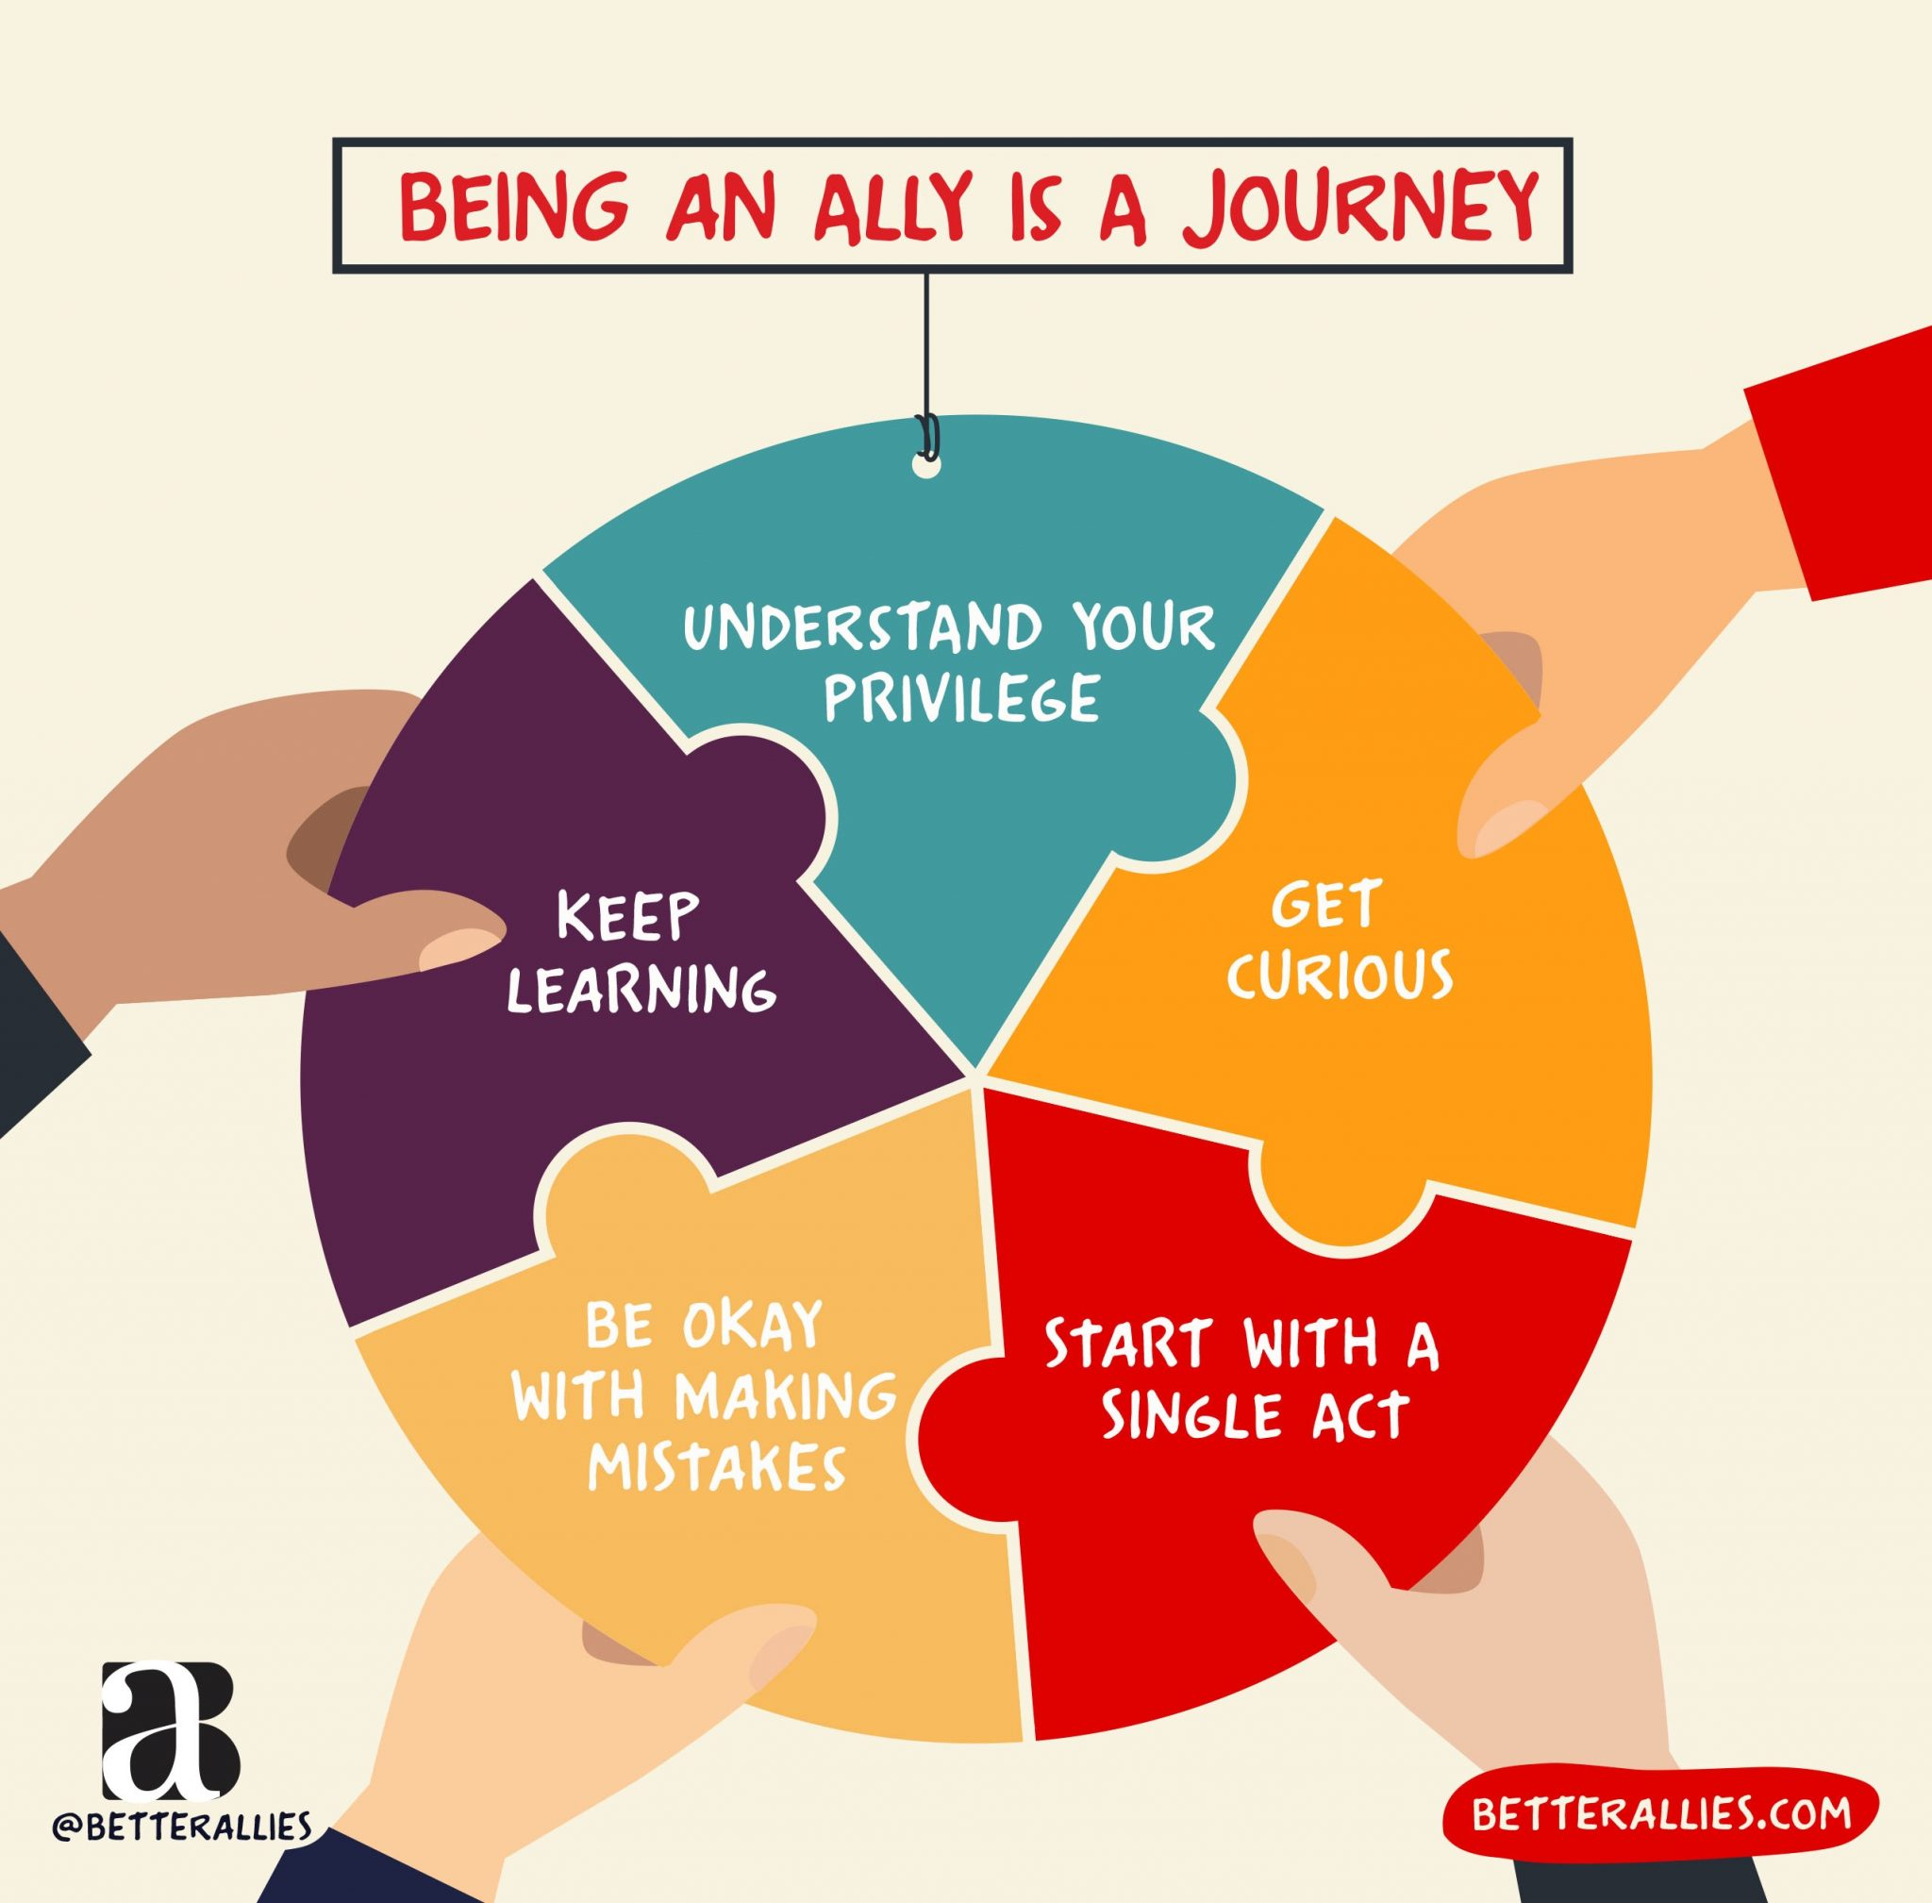
Being a good ally

Slide 17

A future Dublin
That is based on equity
Includes everyone
Strives to improve experiences of all sections of society
Acknowledges the changes in life and populations

Slide 18
Contact:
Dr Arpita Chakraborty
Email: arpita.chakraborty@dcu.ie

